Slide 1
Self-driving vehicle initiative: Overview and dataset
CERSE Meeting 07/08/2024
Speaker: Alejandro Bordallo Micó

Slide 2
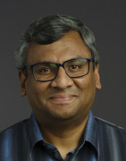
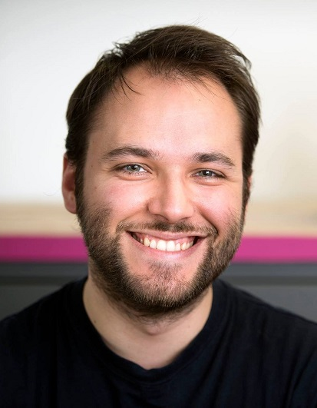
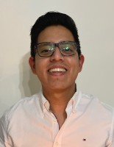
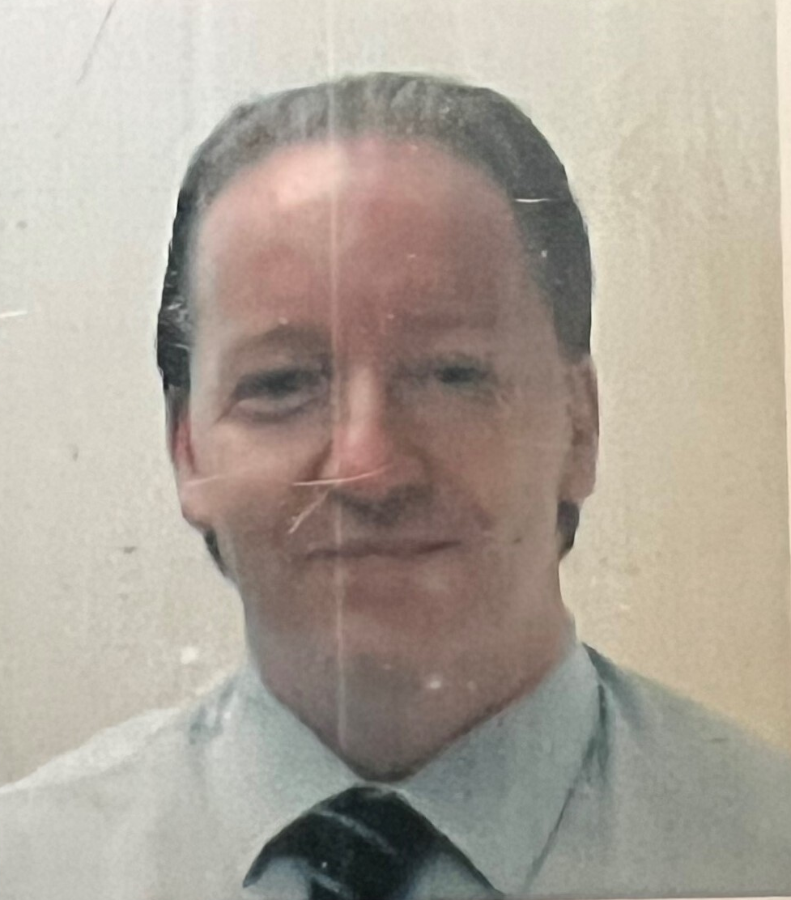
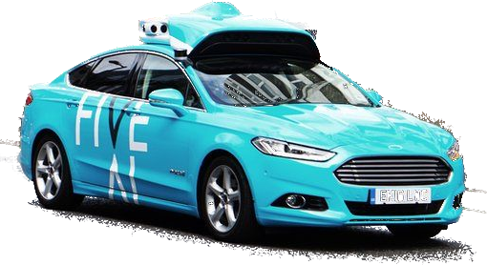
The Team
Ram
Alex
Hector
Jim
LXO

Slide 3
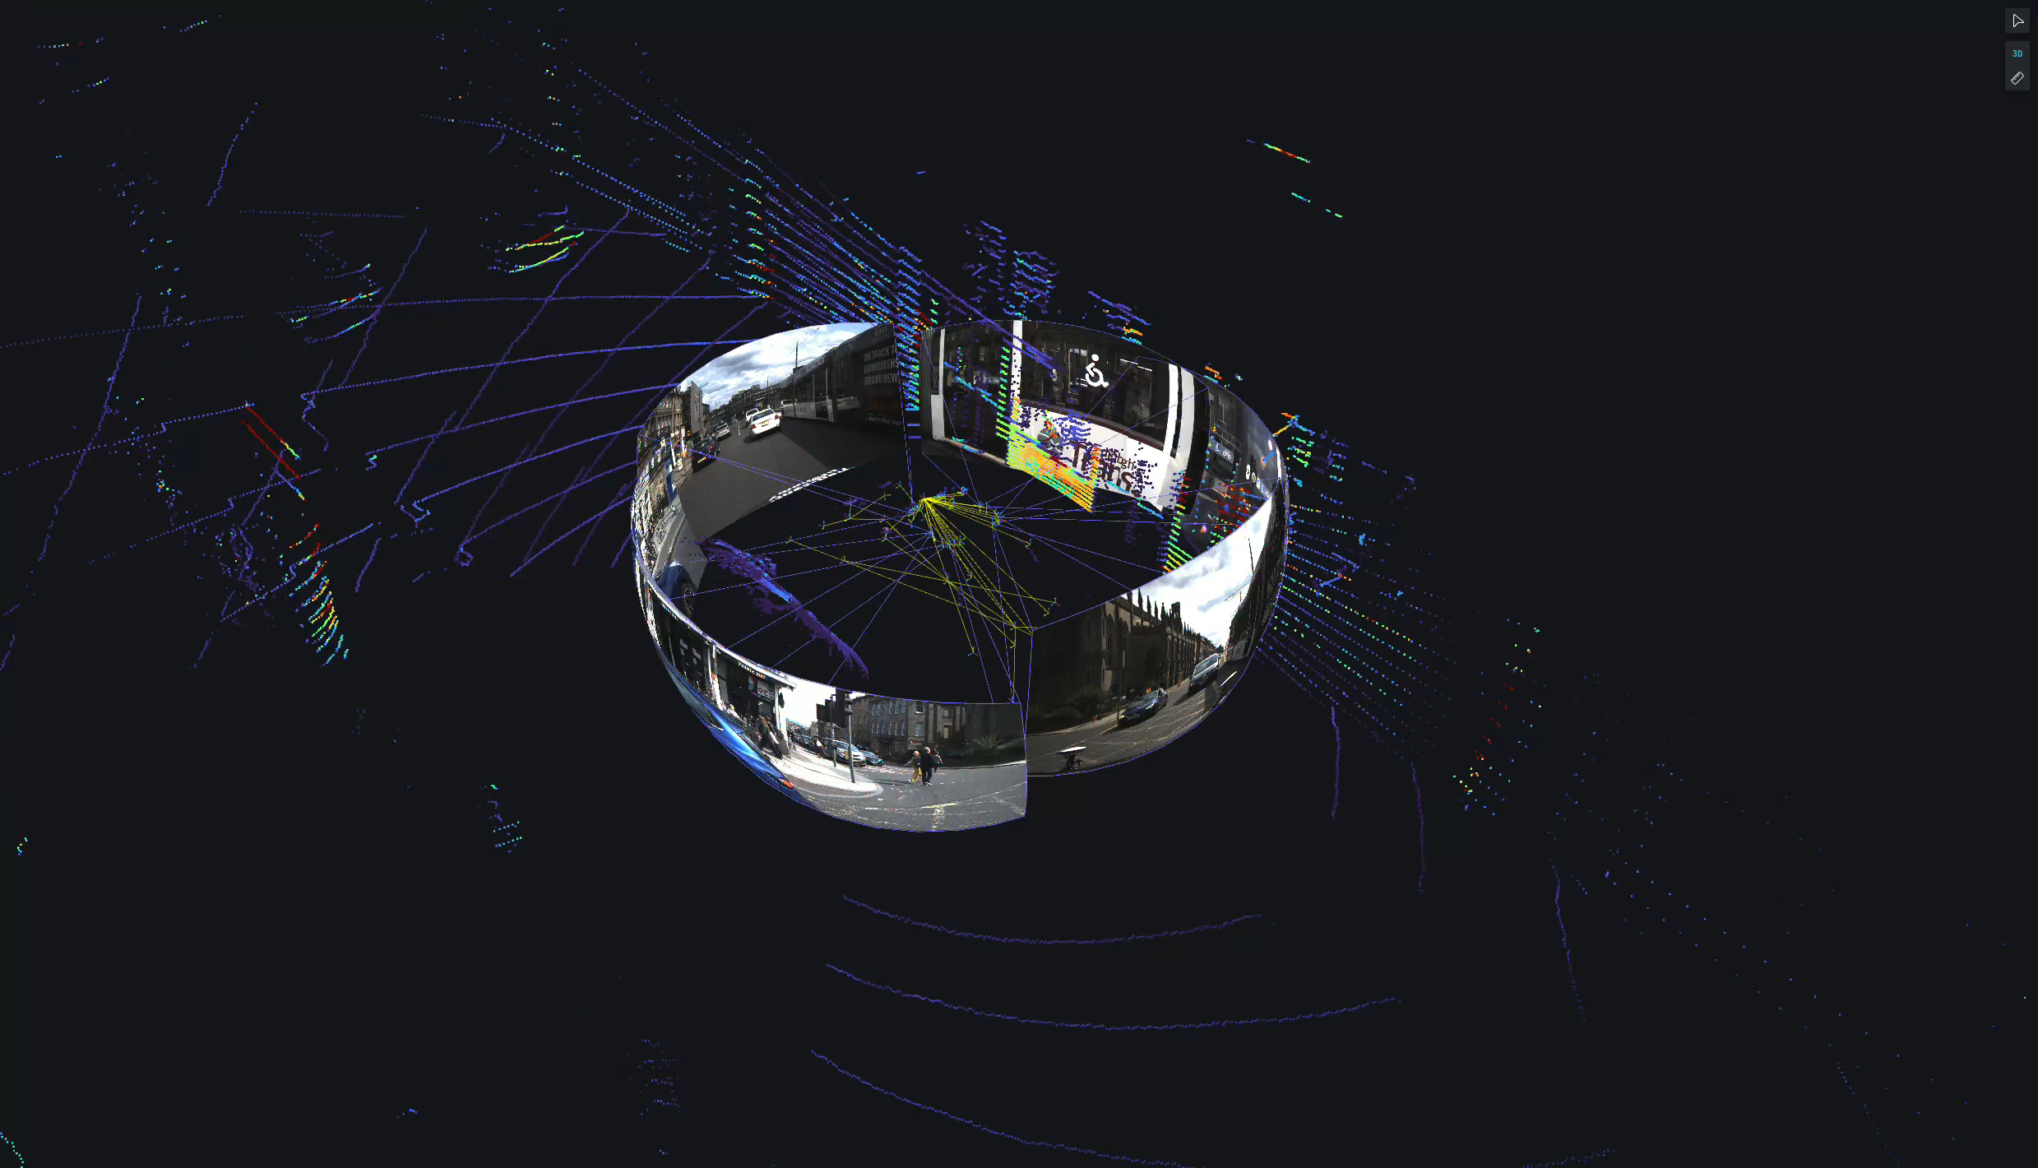
The Autonomous Driving project
Edinburgh city dataset
Dense
Verticality
European
Top-to-bottom data flow
Self-driving stack development
Research domains
Perception
Prediction
Planning
Localisation
Control
Critical safety
Ethics
...

Slide 4
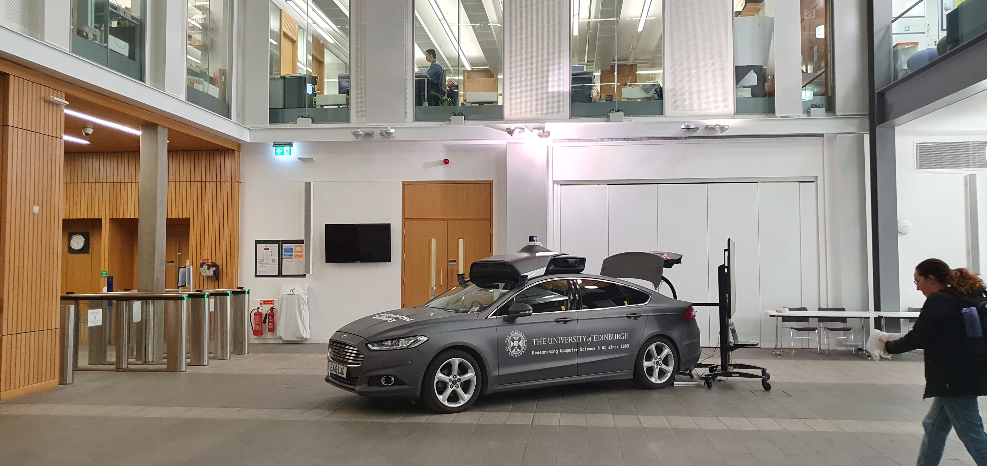
The Hardware

Slide 5
The Hardware
16 x Cameras:
14 x 5MP Chameleon 3 USB RGB cams w/ HW global shutter
2 x extra forward mounts Potential uses: Tele-zoom, IR
3 x Lidars:
1 x top Lidar: Ouster OS2-128 channels
2 x side Lidars: Velodyne VLP-16 channels
8 x Radars:
Continental ARS408
Localisation:
Novatel PwrPak7D GNSS + RTK
Lord GX5-3DM-15 IMU
Computing power:
Twin Xeon CPU E5-2690v4 @ 2.6GHz (56 threads)
256 GB RAM
8 x Nvidia GTX 1080Ti GPUs
Hybrid Ford Mondeo – Donated by FiveAI/Bosch

Slide 6
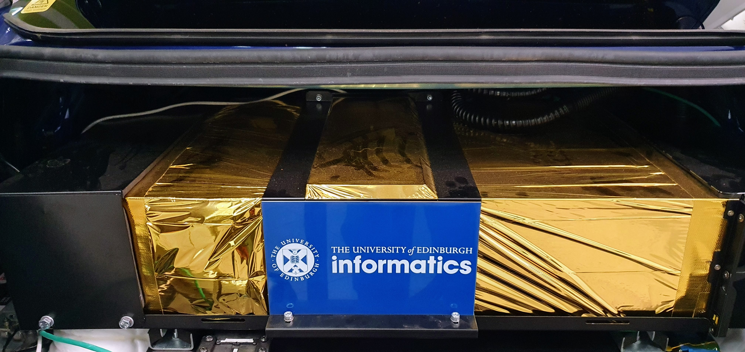
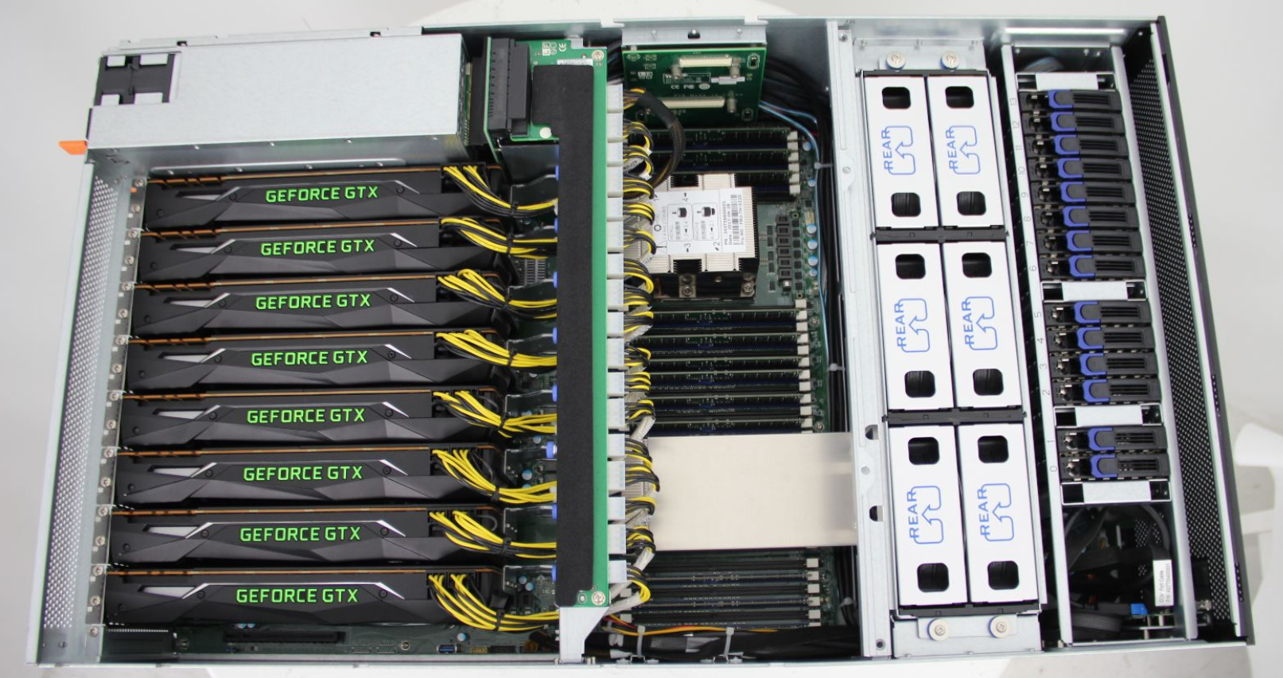
The Software
Meta repository: https://github.com/ipab-rad/tartan_carpet
ROS2 middleware, open-source sensor drivers
Mostly C++, some Python for data/viz scripts
Docker container per component in self-driving software stack
Semantic versioning, CI/CD pipeline
All our software is open source, available in Github
Vehicle control via Dataspeed drive-by-wire (ROS2 -> CANbus)
Autoware as base self-driving software stack https://autoware.org/

Slide 7
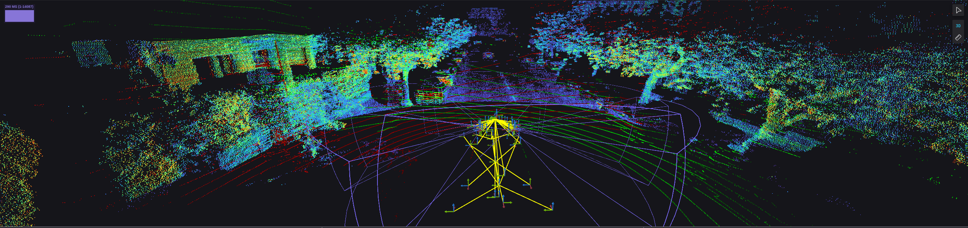
The Data
Data output:
6 x Cameras at 20Hz (Each 1Gb/s)
3 x Lidars at 10Hz (Over 1Gb/s for all three)
Everything else approx. 1Gb/s
About 8Gb of data per second!
After some tricks (e.g. Region-of-Interest, compression): Approx. 5GB ROSbag per 20s chunks (Compressed!)
Aim is to record up to 100TB, so approx. 110 hours of data
Data format:
mcap format (Open source container file format for multimodal log data) https://mcap.dev
"raw" camera (Bayer) + rectified (calibrated) images
Lidar 3D pointclouds
100Hz GPS + RTK corrected pose (up to 2cm accuracy!)
Driver input (e.g. pedals + steering) from drive-by-wire kit
In discussion:
In-car dash-cam footage
Radar detections

Slide 8
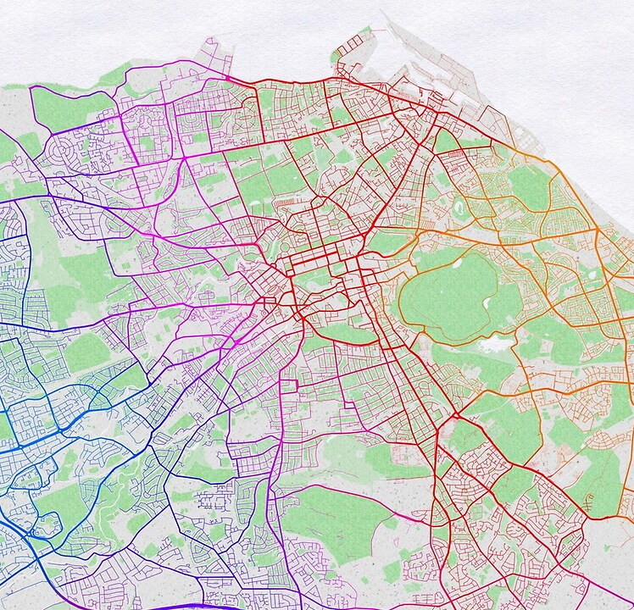
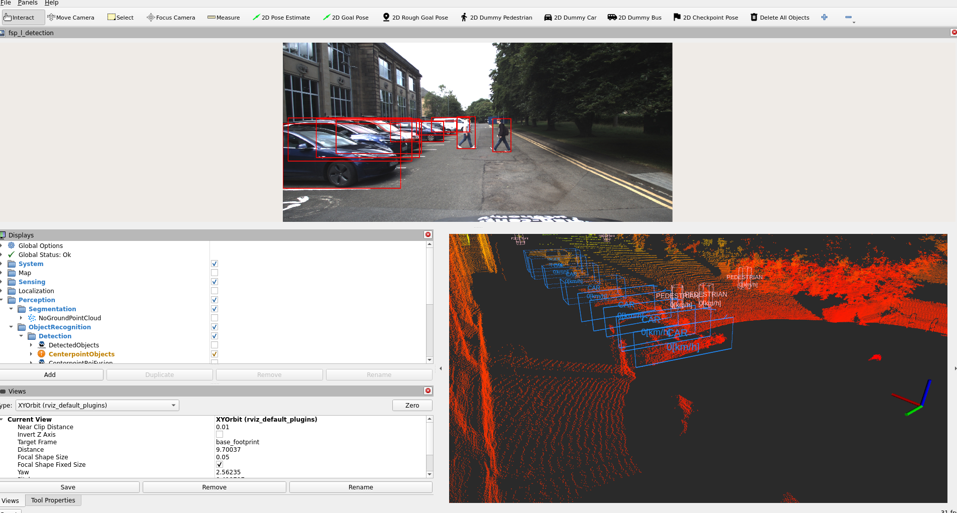
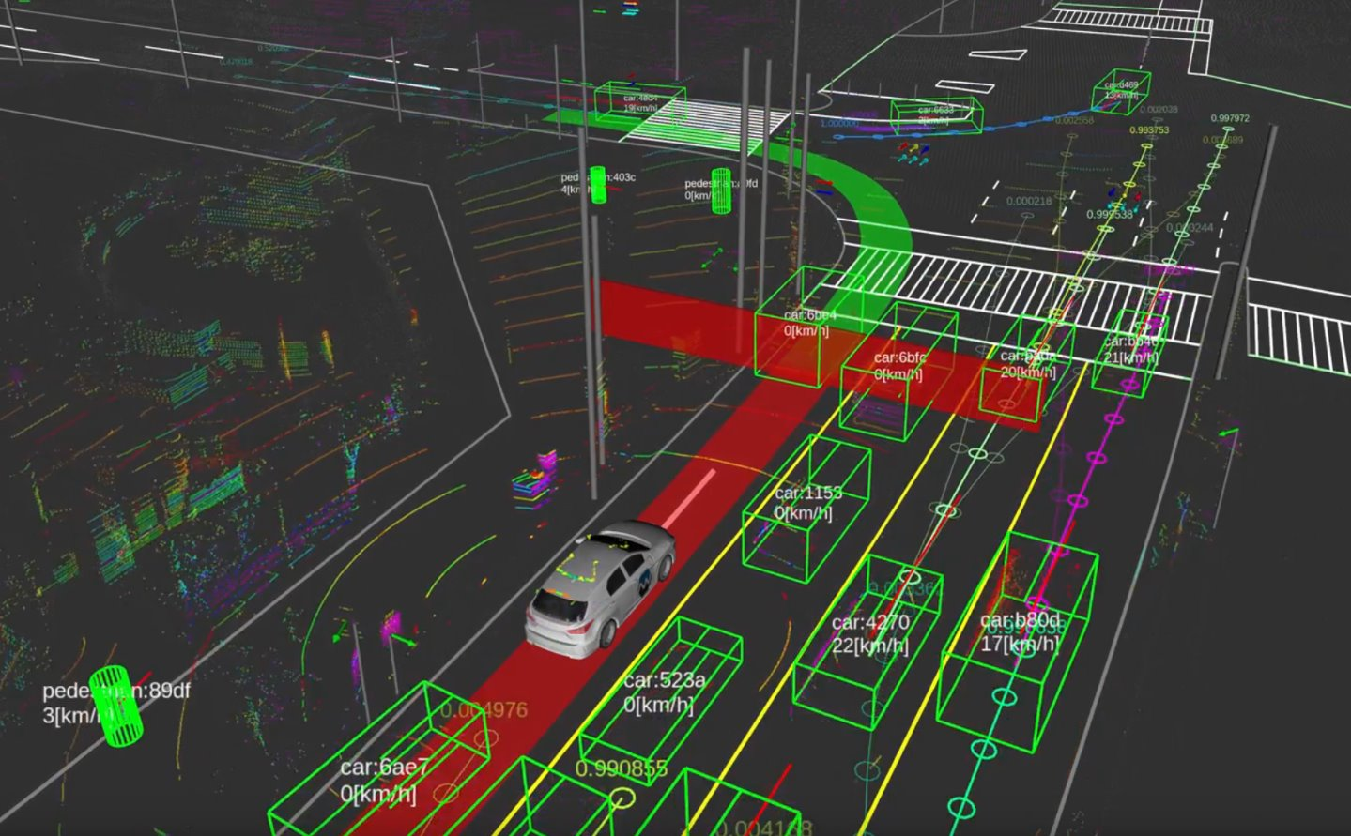

The plan
Data collection around Edinburgh city and surrounding areas
EIDF collaboration for data storage and distribution
Dataset paper publication and public research access
Data analysis with MSc, PhD students and other interested parties
Dataset challenges, benchmarks, support, dataset updates
Development of self-driving stack technologies and trials
Get involved!

Slide 9
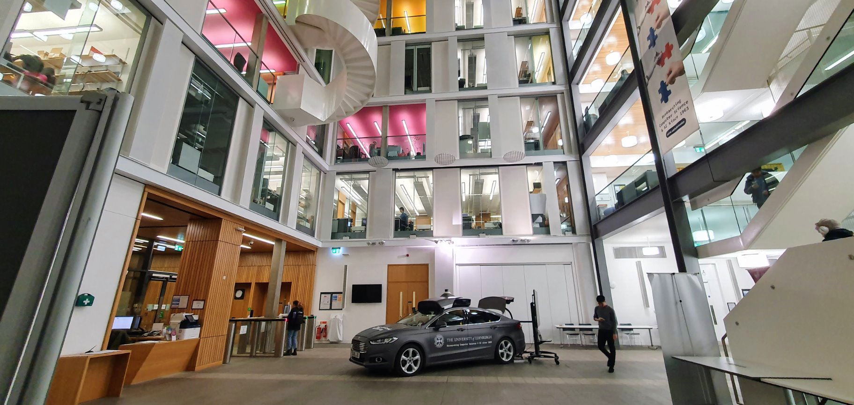
Project lead: Prof. Subramanian Ramamoorthy
Speaker: Dr. Alejandro Bordallo Micó

